Slide 1

KuruKshetra-25(Hackfest)
Team ID – 67
Problem Statement Title - LLM-Based Data Analyst Assistant
Domain/Theme - AIML, Agentic AI, Data Science
Team Name - A.D.O.R
Team Leader Name - Darshan Atkari

Slide 2

Proposed Solution
AI assistant converts natural language questions to SQL queries automatically.
Executes queries on databases/datasets for data retrieval.
Presents insights as charts and graphs.
Supports multimodal and multilingual queries and text-based input.
Empowers non-technical users to easily analyze data without writing SQL.
Idea submission
01

Slide 3
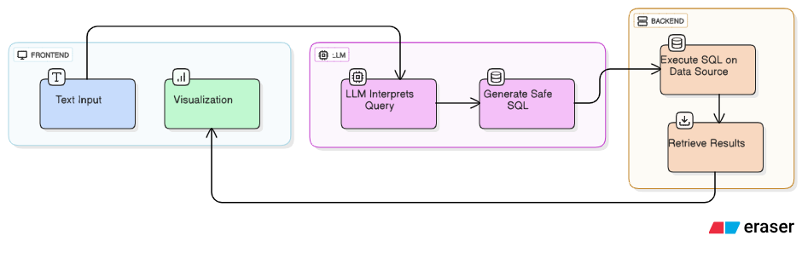
Process flow diagram
Fig. 1 Architecture Diagram
Idea submission
02

Slide 4
Methodology used
Utilize advanced NLP with Llama3 and Gemini 2.5 Pro etc.. for accurate query understanding
Convert natural language to precise SQL using schema-aware Text-to-SQL models
Securely connect to SQLite backend for safe query execution
Generate interactive visual data insights with Plotly and Streamlit
Support multilingual input and outputs.
Idea submission
03

Slide 5
Solution Concept and Feasibility
Combines AI language understanding with automated SQL query generation and execution
Uses existing LLM APIs with lightweight local/cloud databases for quick data access
Employs open-source tools (Streamlit, Plotly) for intuitive data visualization
Ensures privacy with strict query validation and user access control
Scalable for future enhancements and enterprise use
Idea submission
04

Slide 6
Use cases & Description
Empower business analysts to quickly extract insights from sales, customer, and inventory data through simple questions.
Non-technical users like shopkeepers exploring their own data without SQL knowledge
Multilingual support for global teams to query data in local languages
Real-time answers with dynamic visuals for meetings and reports
Data-driven decisions through instant explanations and graphical summaries
Idea submission
05

Slide 7




Technology stack used
LLM: Llama3, codellama or Gemini2.5 pro etc..
Backend Programming: Python, Pandas.
Database: SQLite, MySQL
Frontend/UI: Streamlit, HTML, CSS
Data Visualization: Plotly, PyPlot.
Idea submission
06

Slide 8
Constraints
Considerations
Protect sensitive data and ensure authorized access (Privacy)
Manage API usage and infrastructure expenses efficiently (Cost)
Challenges
Securing data queries from unauthorized access and injection attacks
High OpenAI API and cloud costs with increasing usage
Solutions
Implement user authentication and query validation
Optimize queries and monitor API usage to reduce costs
Idea submission
08

Slide 9
